Slide 1




INTRODUCTION
Android Women’s Safety App
“DefendHER”
“Empowering Women, Ensuring Safety:
Your Guardian in Every Pocket."
SALVIA R. D’SOUZA
&
ANCHAL M. TIWARI

Slide 2


ABOUT
This app serves as a reliable companion, utilizing cutting-edge technology to address the unique challenges women may encounter in their daily lives.
As we navigate the complexities of safety in the modern era, DefendHER stands as a testament to the commitment of creating a world where every woman feels protected, confident, and in control.

Slide 3
ABSTRACT
DefendHER is a comprehensive safety solution that incorporates a myriad of features, including emergency helpline numbers, actionable self-defense tips, a swift SOS panic button, discreet location sharing via SMS, and a repository of essential women's rights laws.
Furthermore, DefendHER is dedicated to always evolving and adapting to the changing requirements and issues that women confront. We keep DefendHER at the forefront of edge of personal safety innovation by providing continuous improvement and enhancements.
Whether it's integrating new features, improving existing functionalities, or extending our network of support services, DefendHER is committed to staying ahead of the curve and giving women the skills they require to navigate the complexity of personal safety with confidence and resilience.

Slide 4

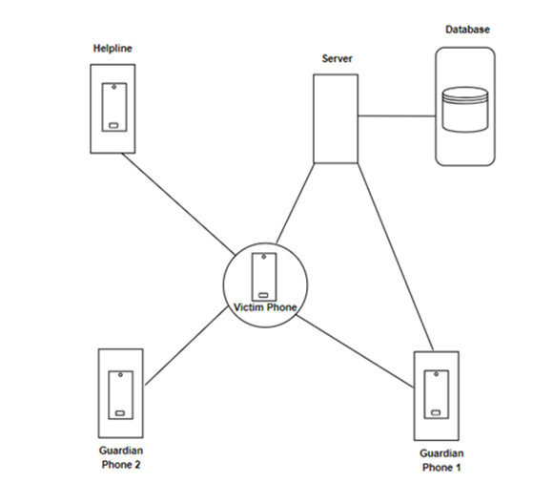
Architecture
Victim Phone: This represents the smartphone carried by the woman who needs to use the safety features of the application.
Guardian Phone(s): These represent the smartphones of pre-defined contacts (guardians) who will receive alerts when the victim triggers a safety feature. There can be multiple guardian phones configured in the app.
Server: This is a central server that coordinates communication between the victim's phone and the guardian phones. The victim's phone transmits alerts to the server, which then relays them to the designated guardian phones.
Helpline: The architecture also includes a helpline number, which the victim can potentially access through the app to connect with emergency services.

Slide 5



Features
Emergency Contacts
Safety Tips and Laws
Distress Button (SOS)
Location Sharing via SMS

Slide 6



Advantages
Help Alert
Enhanced Safety
Shifting social norms
Location Sharing & Real time tracking
Increased reporting

Slide 7


Drawbacks
Privacy Concerns
Risk of False Alarm
Limited Technical Reach

Slide 8




Purpose
The need for women's safety apps arises from the unfortunate reality that women, like any other demographic, can face various safety concerns and potential threats in their daily lives.
Personal Safety and Security of Women by Leveraging Technology
Providing a Sense of Autonomy and Control
Raising Awareness and Public Education by Breaking Barriers

Slide 9




Future Prospects
Community Engagement Features
Personal Safety and Security of Women by Leveraging Technology
Artificial Intelligence for Personalized Safety and chatbot
Providing a Sense of Autonomy and Control
Raising Awareness and Public Education
Breaking Barriers by Empowering
Women to Navigate Public Spaces
Offline Mode with Emergency Features

Slide 10


t
References
AbhiRaksha: Advanced Women Safety App. Behance. AbhiRaksha: Advanced Women Safety App. Behance. https://www.behance.net/gallery/93648247/AbhiRaksha-Advanced-Women-Safety-App
Crime Against Women in India: A Look at NCRB Report 2023. NewsClick. https://www.newsclick.in/crime-against-women-india-4-ncrb-report-2023
Srinivas, K., Gothane, S., Krithika, C. S., Anshika, & Susmitha, T. (2024). Android App for Women Safety. International Journal of Scientific Research in Computer Science, Engineering and Information Technology, 24(5), 378. https://doi.org/10.32628/CSEIT1217368
Wikipedia (Violence against Women in India):
https://en.wikipedia.org/wiki/Violence_against_women_in_India

Slide 11

CONCLUSION
In conclusion, DefendHER stands as a powerful tool in championing women's safety, offering a comprehensive suite of features designed to empower and protect. By seamlessly integrating real-time tracking, emergency alerts, and community support
DefendHER is more than an app; it's a guardian, providing a sense of security in every pocket. As we navigate the digital landscape of safety, DefendHER remains committed to its mission of ensuring the well-being and confidence of every user.
DefendHER—a steadfast companion in your journey toward a safer, more secure future. Let’s continue illuminating our way forward.

Slide 12


"Empowered women, Empower women."

